Slide 1
Team Foundation Server & Visual Studio Team Services Hands On Labs
Dave Burnison – Technology Solutions Professional Microsoft Corporation
Dave.Burnison@Microsoft.com
Notes:
Created by Dave Burnison, 5/24/2017. Please contact me if you make any notable updates to these slides so that we can share your great work with others.
Let me know if you have any questions or comments.

Slide 2
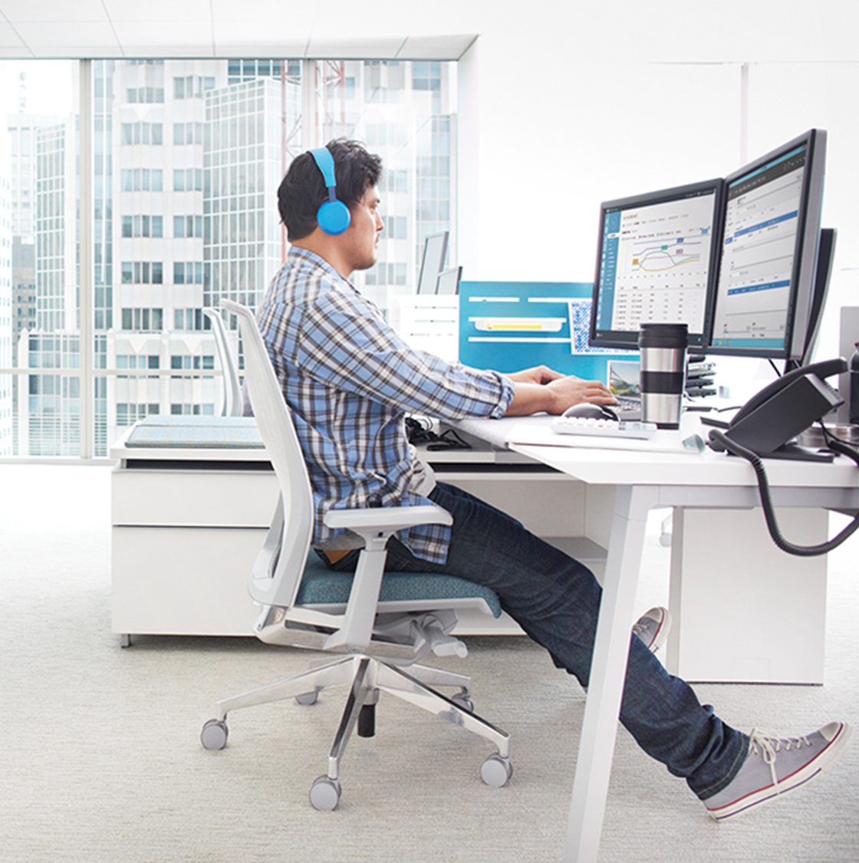
Get Hands On Experience with TFS and VSTS
TechNet Virtual Labs
The Visual Studio ALM Labs are available on Microsoft TechNet Virtual Labs. You can experience the labs right from within your browser. It's very simple - there is no complex setup or installation required.
Visual Studio Team Services Labs We have a set of hands-on-labs based on Visual Studio Team Services. You can use any machine that has Visual Studio 2017 or higher installed to follow the lab materials.
If you don’t have Visual Studio 2017, use your MSDN Azure credits to spin up a VM in Azure with VS 2017 already installed!
Notes:
NOTE: If you want to discuss creating a VS VM in Azure, the next slide may be hidden. You would have select “See all slides” in the “Presenter View” and manually select the slide.

Slide 3
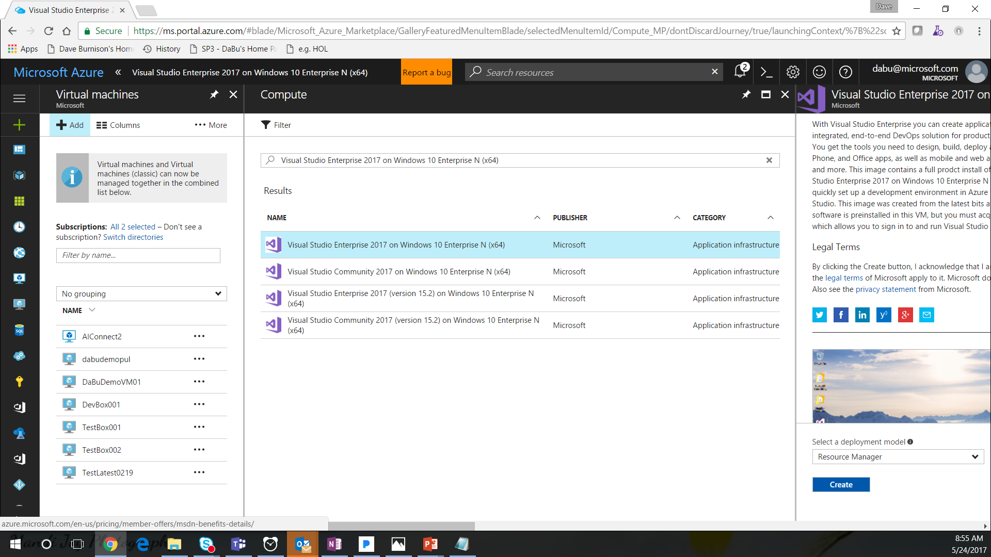
Notes:
Go to your Azure portal and select Virtual Machine
Click “Add”
Search existing images for “Visual Studio 2017”
Select the desired image
Click “Create”

Slide 4
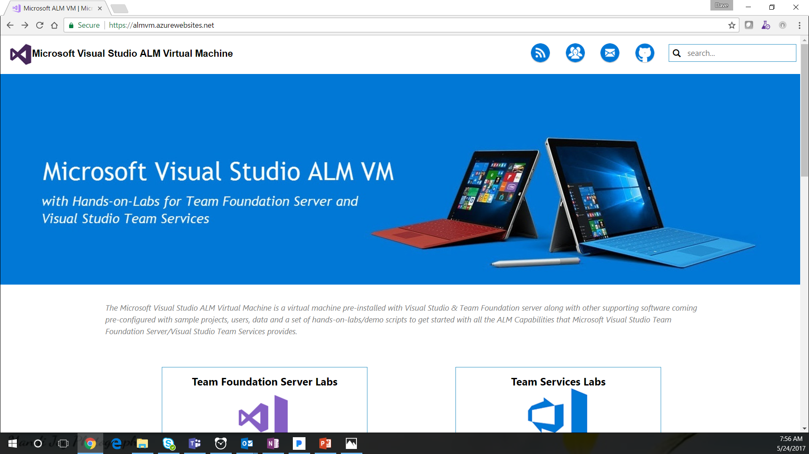
Notes:
“Open the browser and go to https://almvm.azurewebsites.net/”

Slide 5
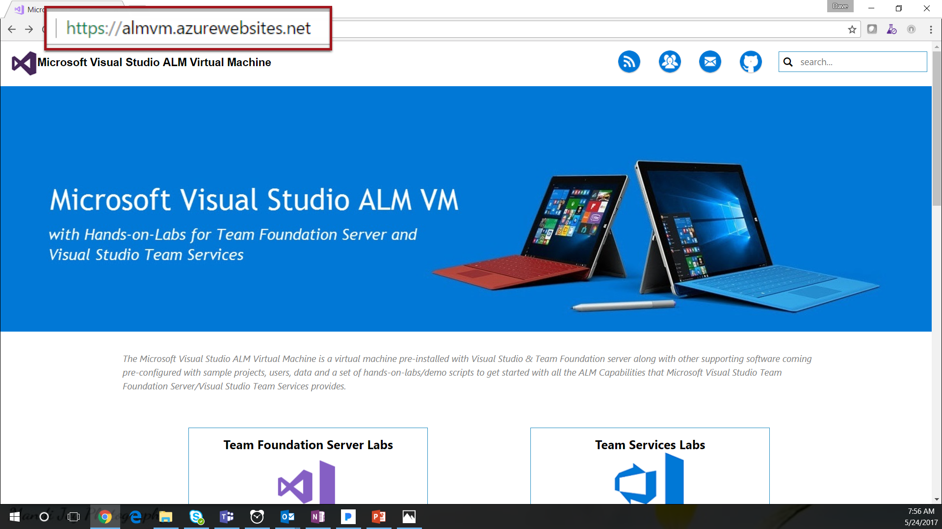
Notes:
“Let’s scroll down to see the TechNet virtual labs.“
[Click the mouse on the scroll bar]

Slide 6
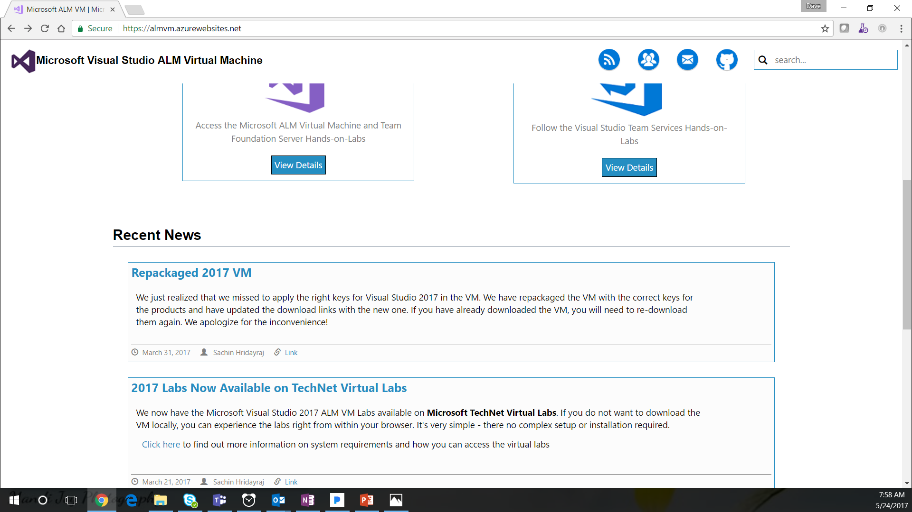
Notes:
[Click]
Highlight the TechNet Virtual Labs on the page.
[Click on the “2017 Labs Now Available on TechNet Virtual Labs” link]

Slide 7
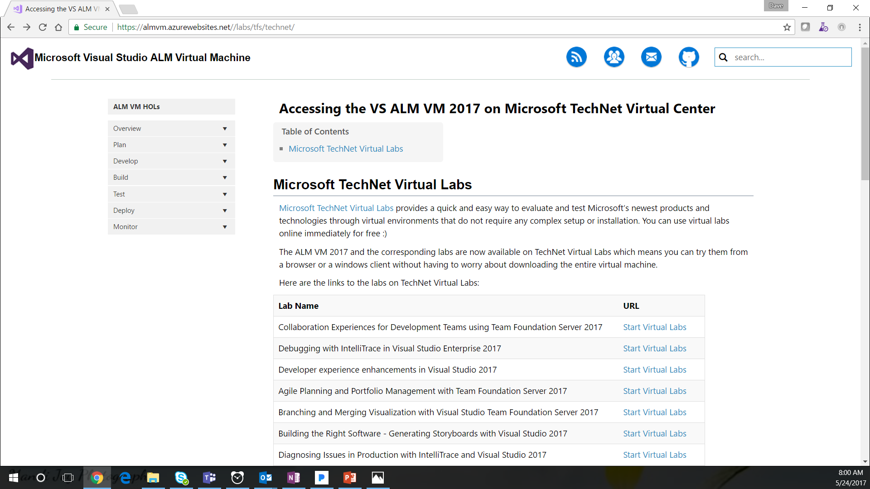
Notes:
“Scroll down to the ‘Introduction to Team Foundation Build 2017’ lab”
[Click the mouse on the scroll bar]

Slide 8
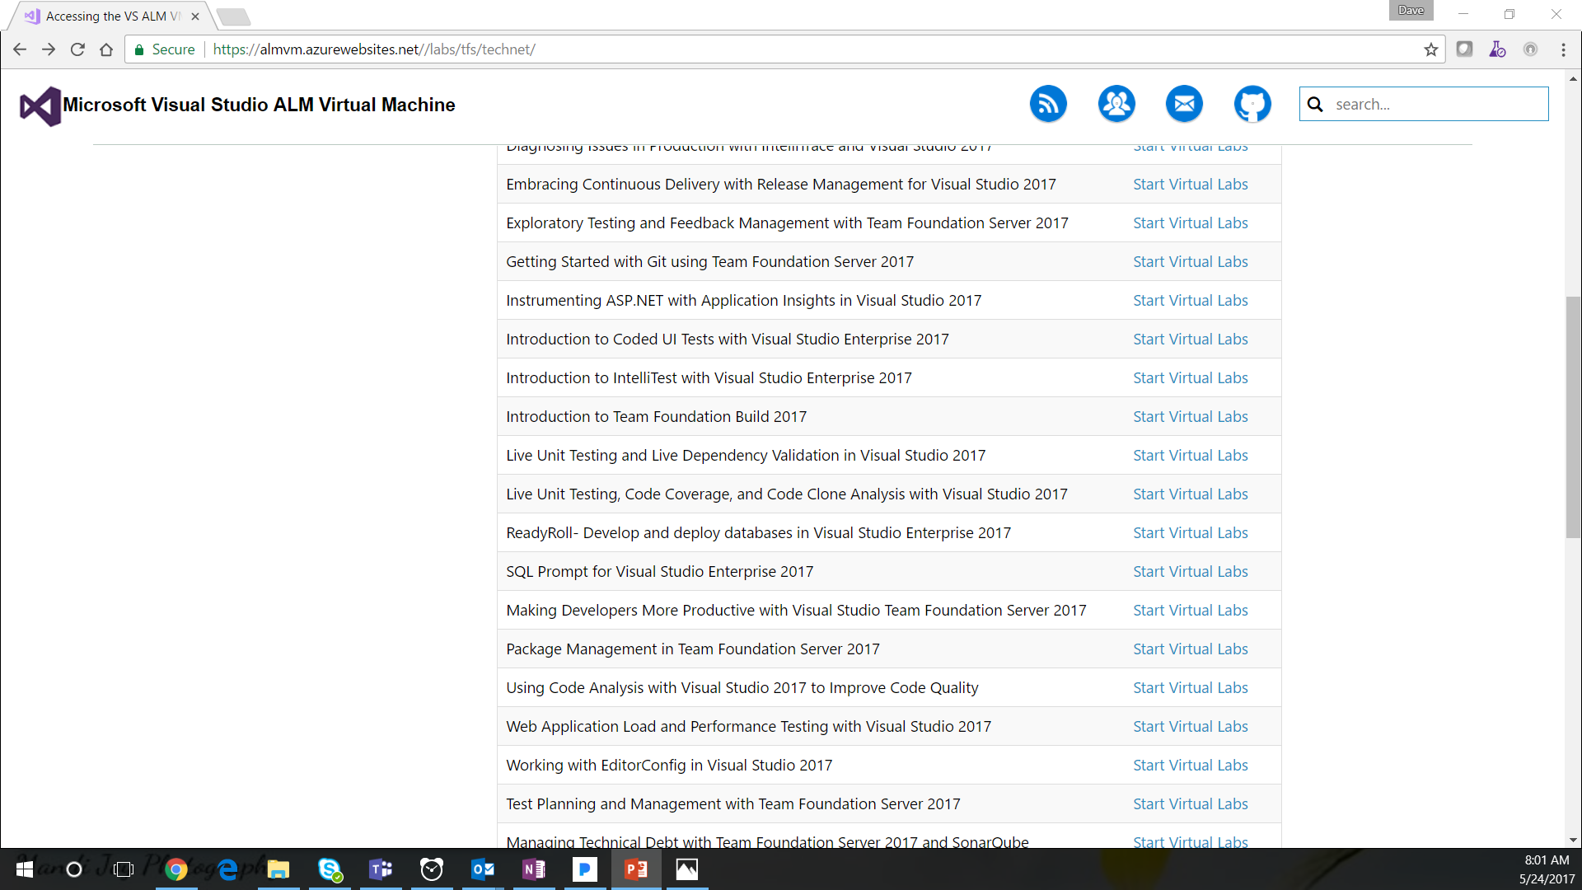
Notes:
“Let’s run the lab”
[Click on the “Start Virtual Labs” link]

Slide 9
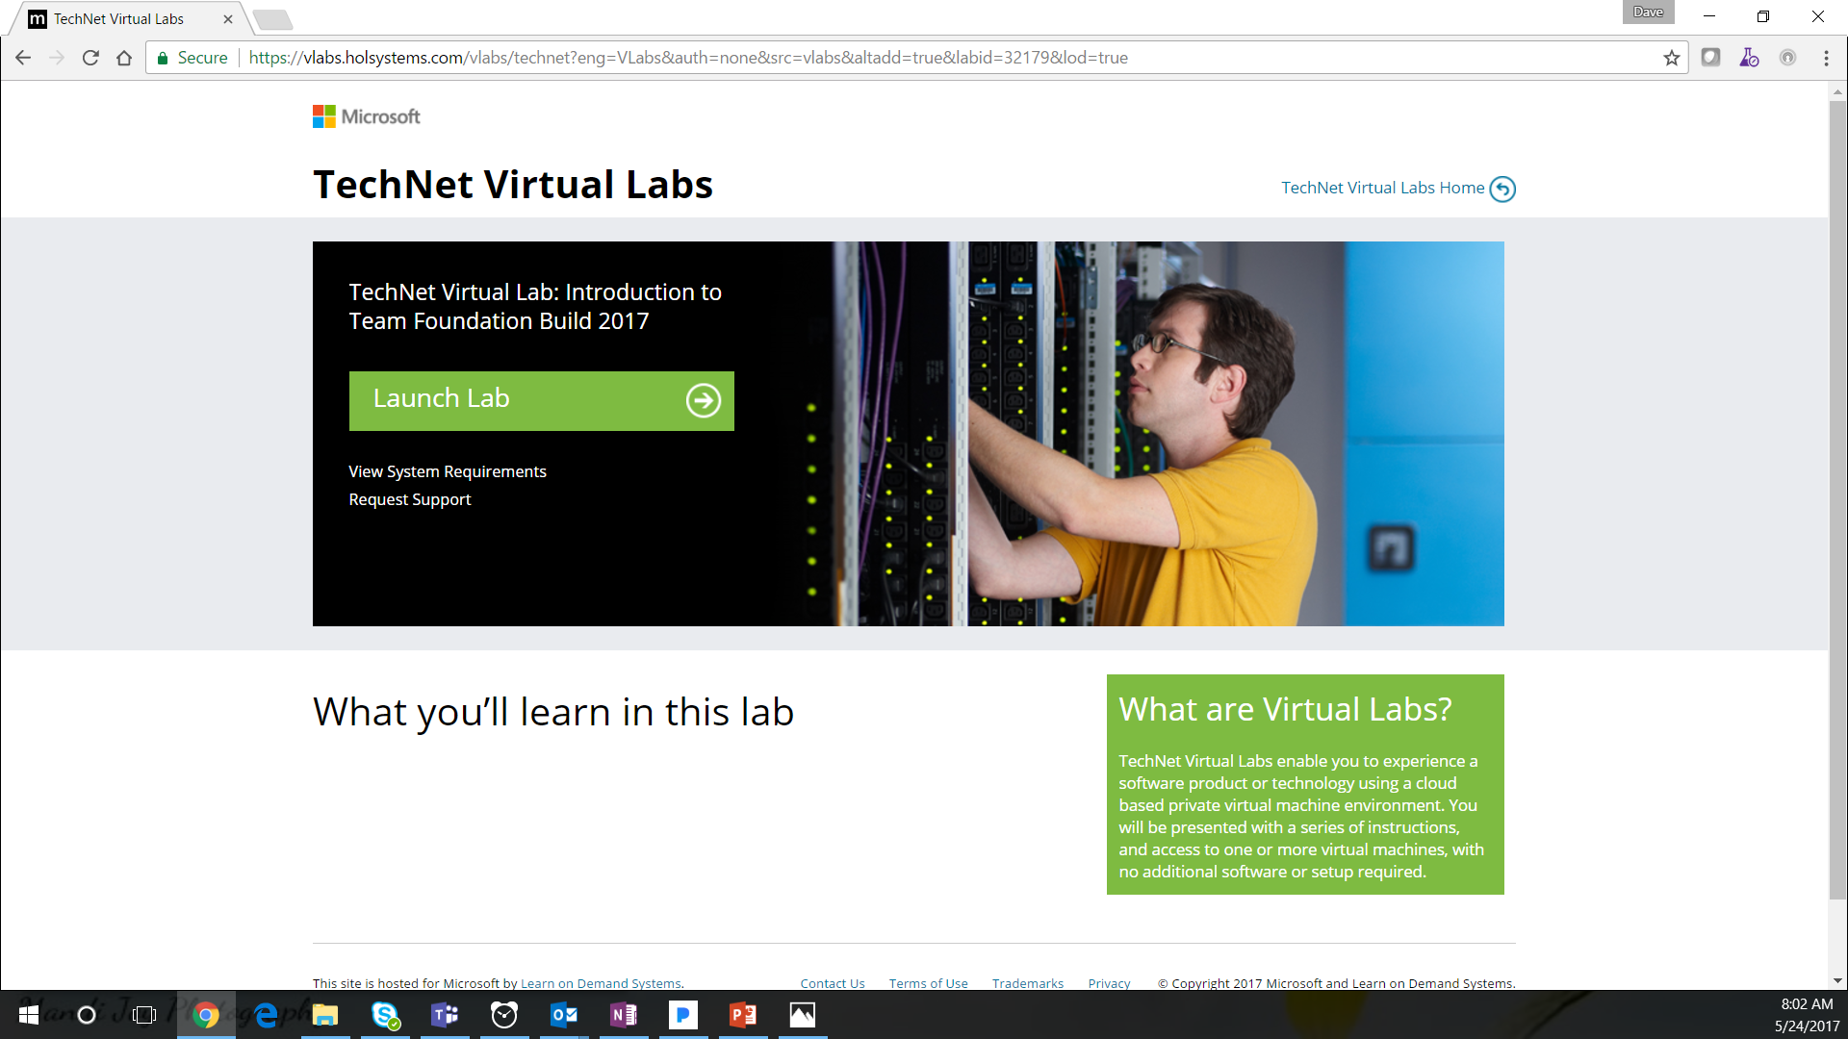
Notes:
“We need to sign in and launch the lab”
[Click the “Launch Lab” Button]

Slide 10
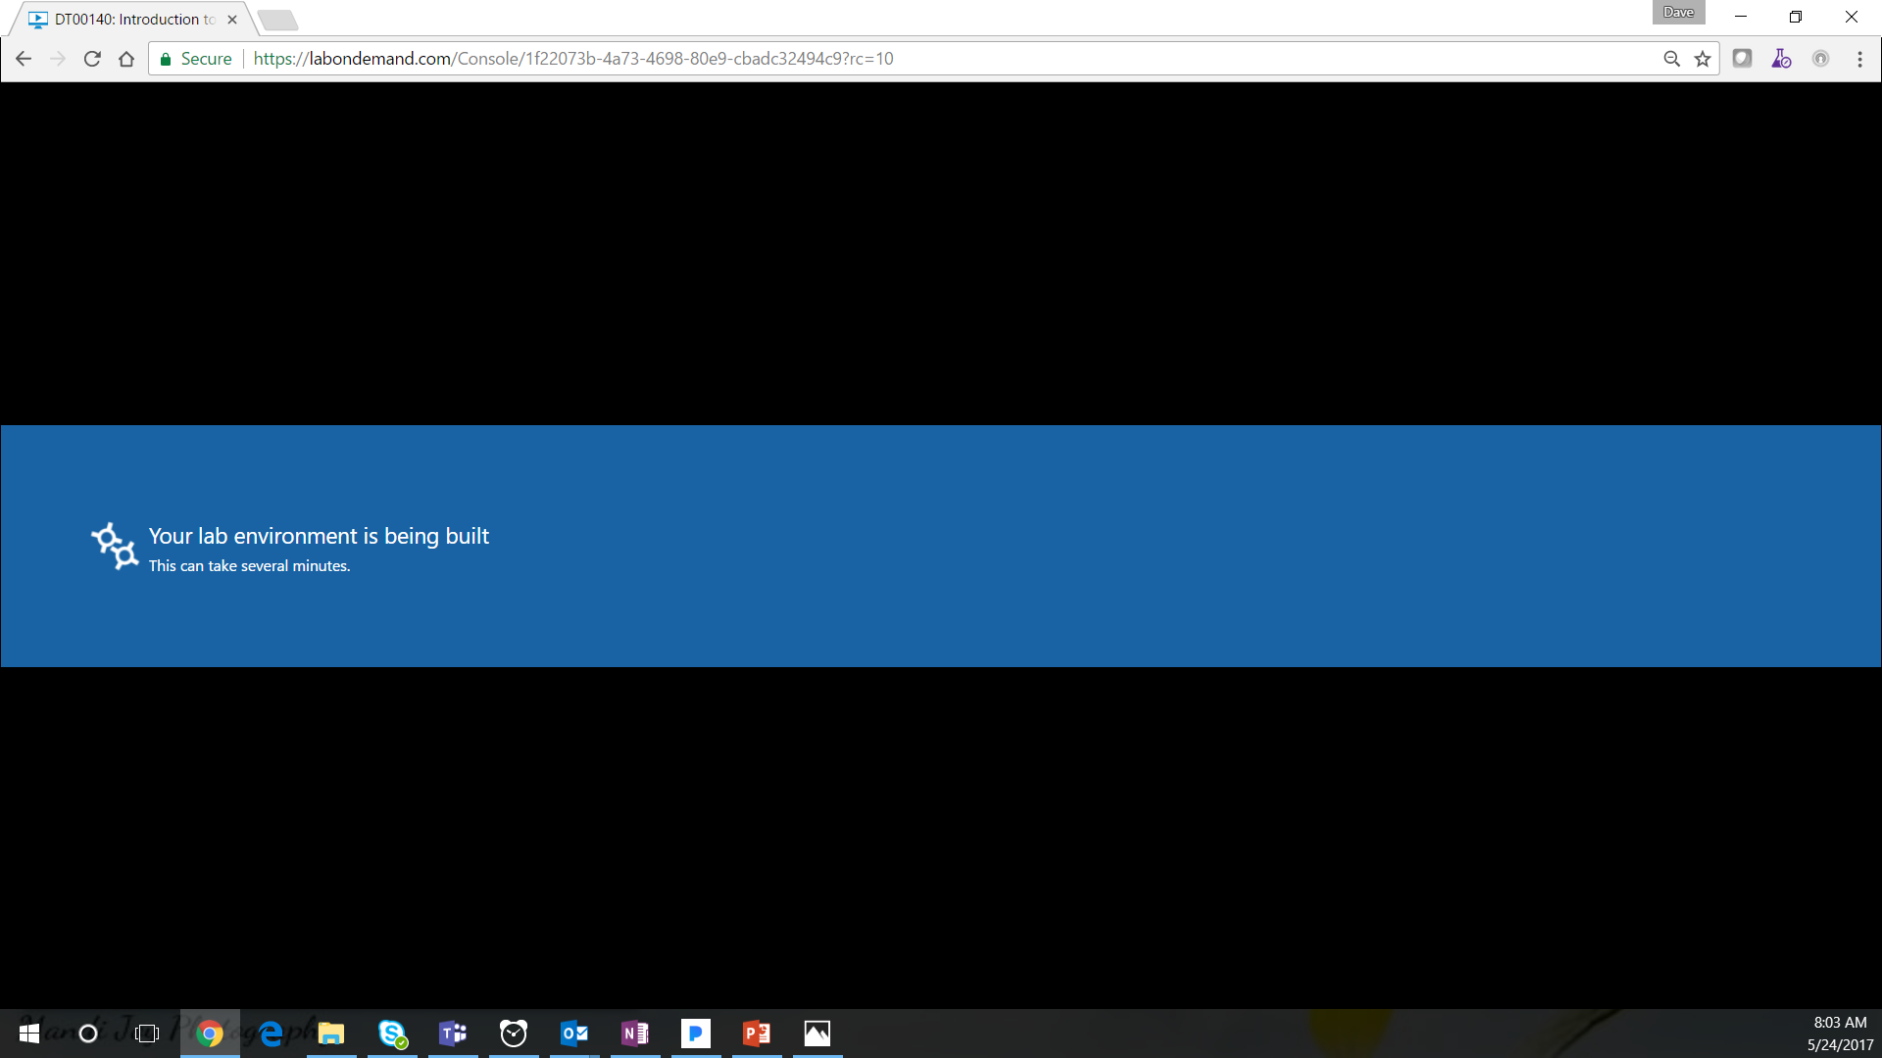
Notes:
“It may take a few minutes to spin up the virtual machine”
[Click]

Slide 11
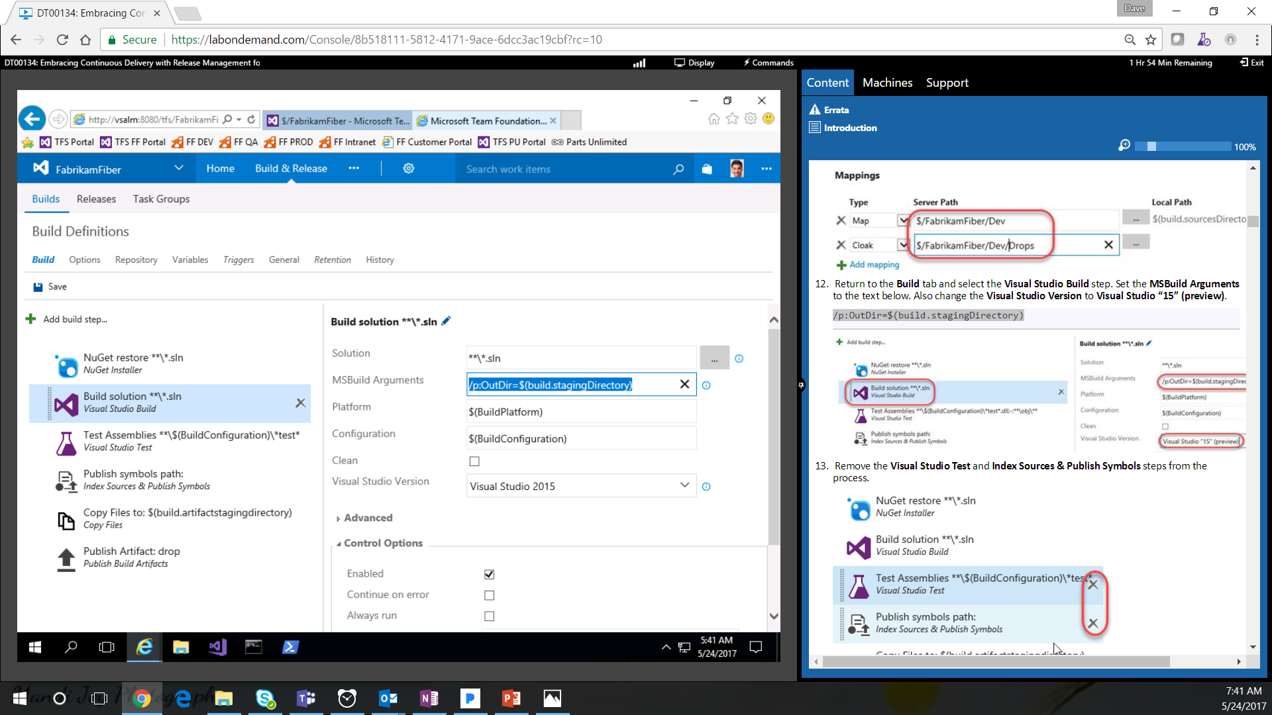
Virtual Machine
Lab Instructions
Notes:
“Now you have a virtual machine…”
[Click]
“…and a set of lab instructions…
[Click]
“…that you can use to get hands on experience with TFS…And you didn’t have to setup any new VMs, install any software, etc.!”

Slide 12
Notes:
“Now let’s check out the Visual Studio Team Services Labs”
[Click]

Slide 13
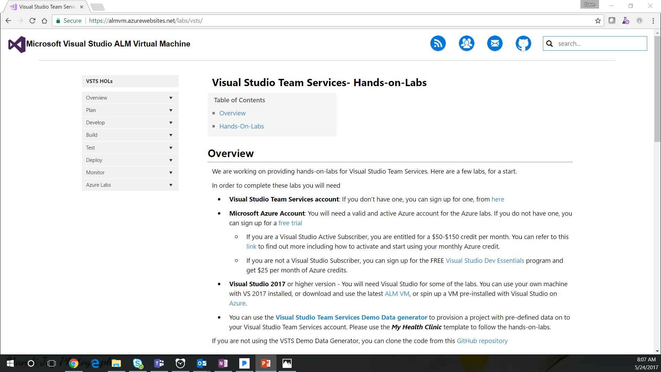
Notes:
Point out the requirements for running these labs.
Emphasize that the demo generator will give you the source code, work items, etc. that you need to complete any of these labs.
“Let’s run the ‘Load Testing with Visual Studio Team Services’ lab”
[Click the mouse on the scroll bar]

Slide 14
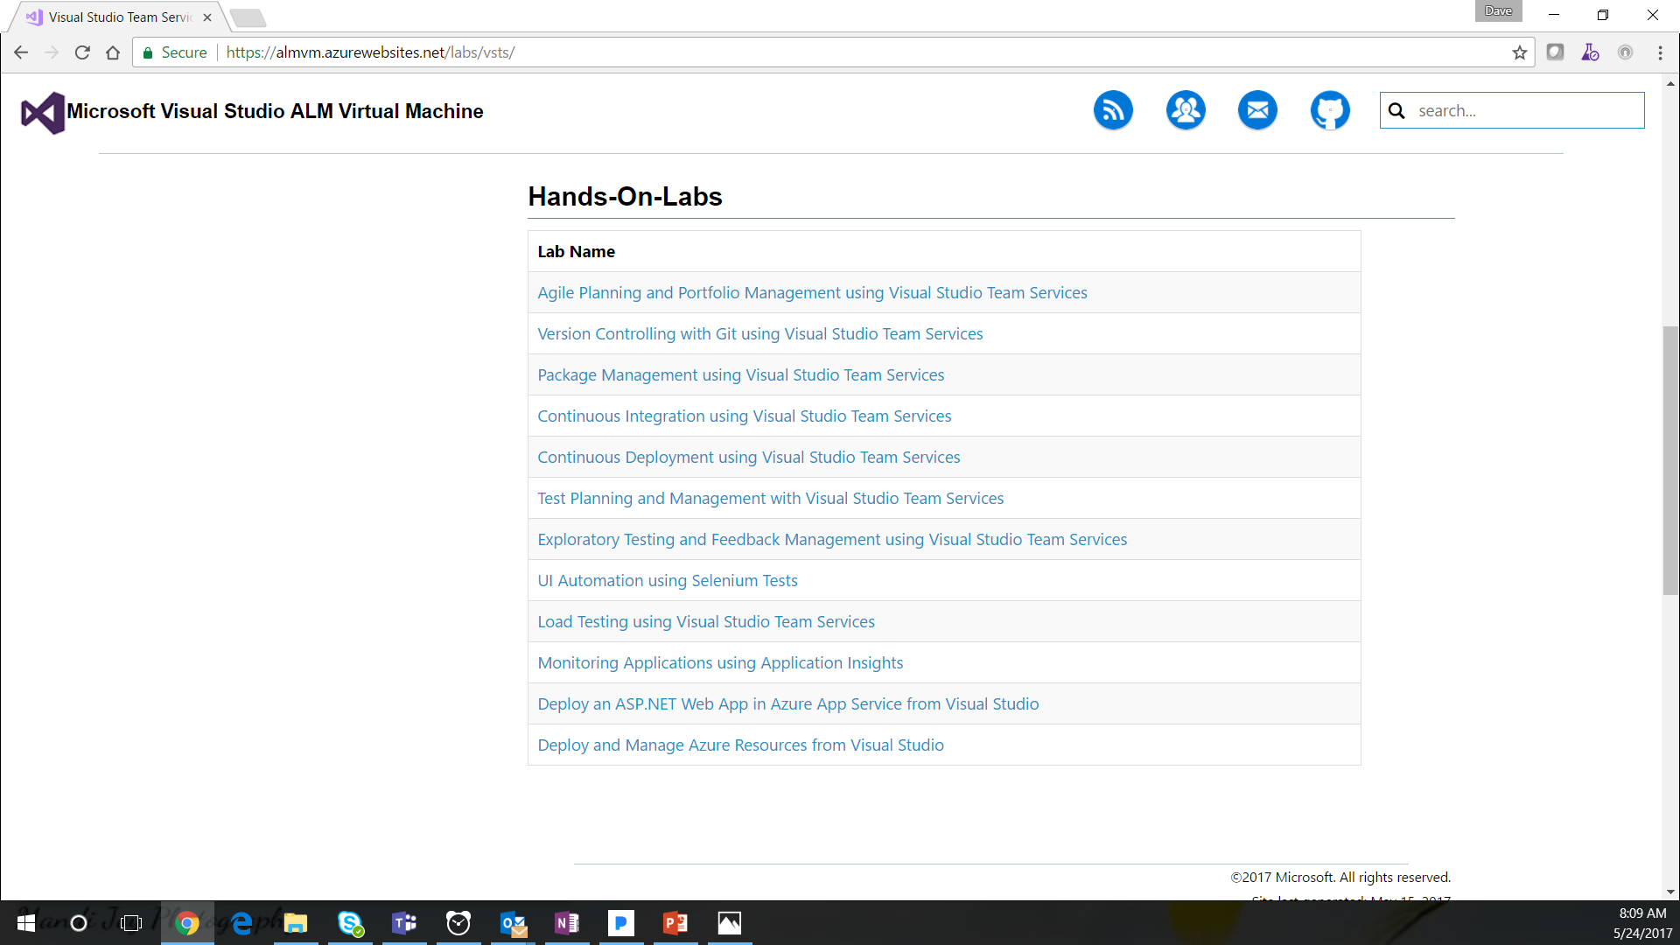
Notes:
“Let’s open the hands on lab in this browser and start another browser for VSTS”

Slide 15
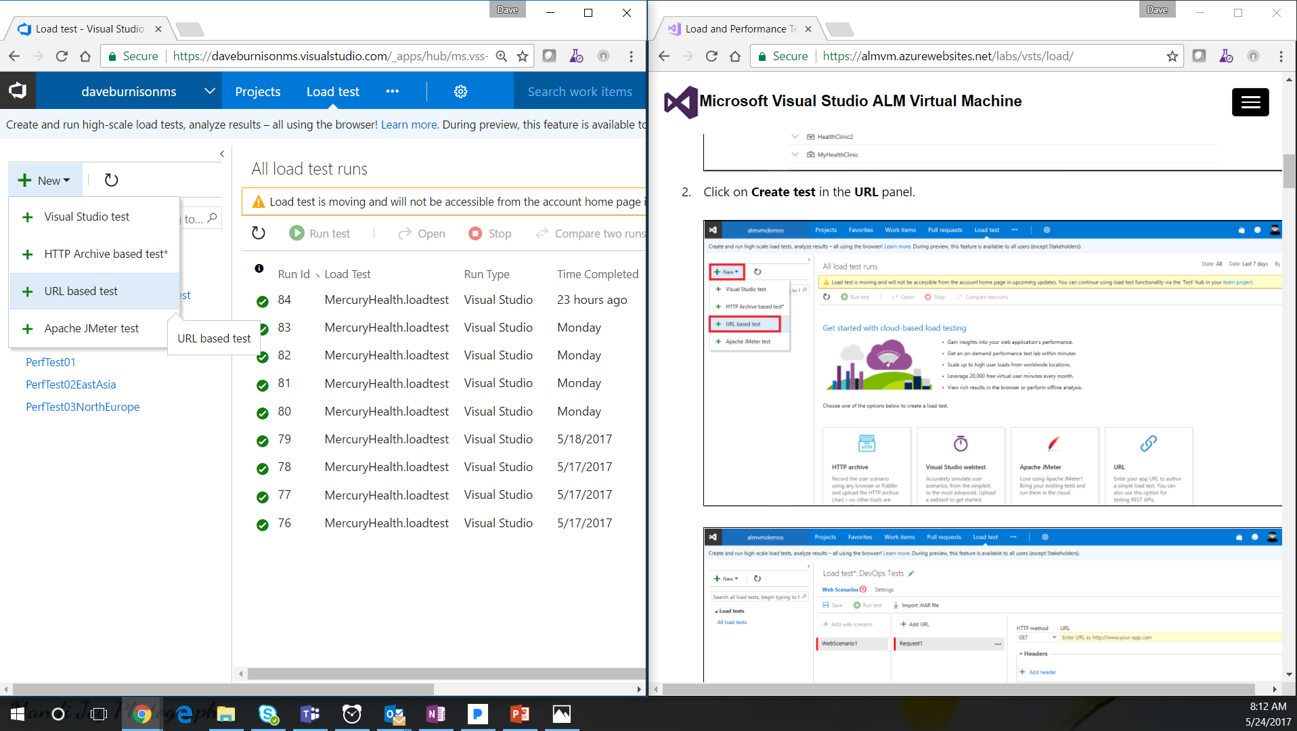
Lab Instructions in Browser #2
VSTS in Browser #1
Notes:
“Now you have your new VSTS account running in one browser …”
[Click]
“…and a set of lab instructions in a second browser…
[Click]
“…that you can use to get hands on experience with VSTS. As a bonus, you can continue to use this VSTS account and the “My Health Clinic” team project as a reference and sandbox for more learning and investigation even after you have completed the lab!”

Slide 16
Get started today! https://ALMVM.AzureWebsites.net/

